Slide 1

The Third Space
Web based platform to promote arts & crafts and DIY projects from Pakistan, earn money through purchases and facilitate the marginalized communities

Slide 2
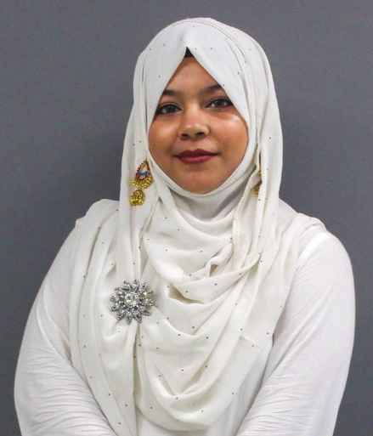
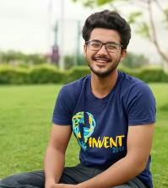
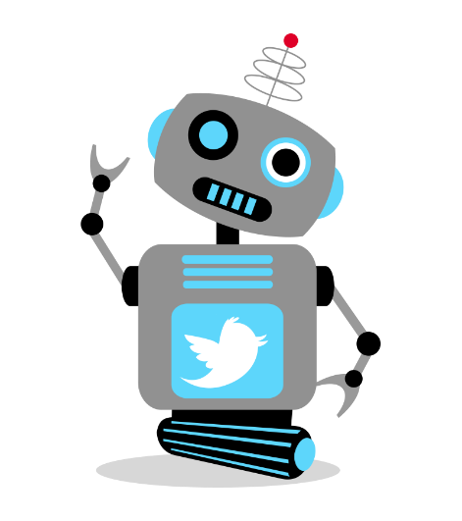
Team Members
We are a diverse team of individuals eager to impact the society for the greater cause.
Aiman Ahmed Moin
CS 2020
Server side development of website
UI design & illustration
Ubaid Ali Faruqi
CS 2020
UI design
Scrum master
Client-side development
Ahsan Qadeer
CS 2020
Full stack developer
Quality assurance
Databases and UI design

Slide 3
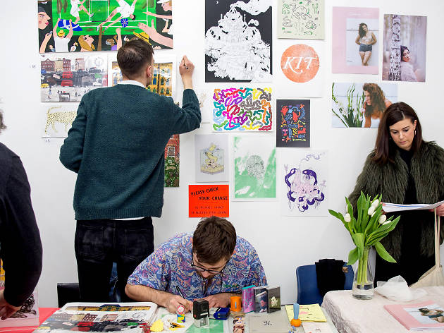
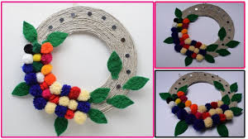

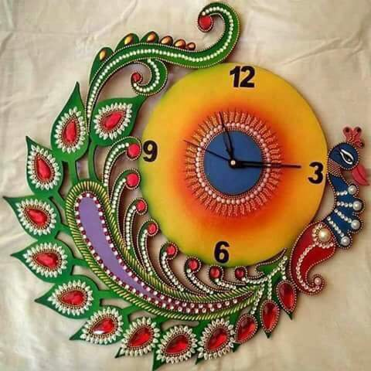
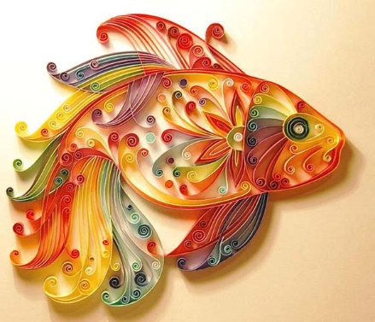
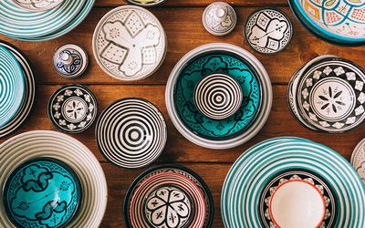
Neglected Issues in Our Society
Rights and Employment of Transgender.
Job Opportunities.
Web based platform to facilitate artists and skilled workers
94.2% unemployment rate

Slide 4
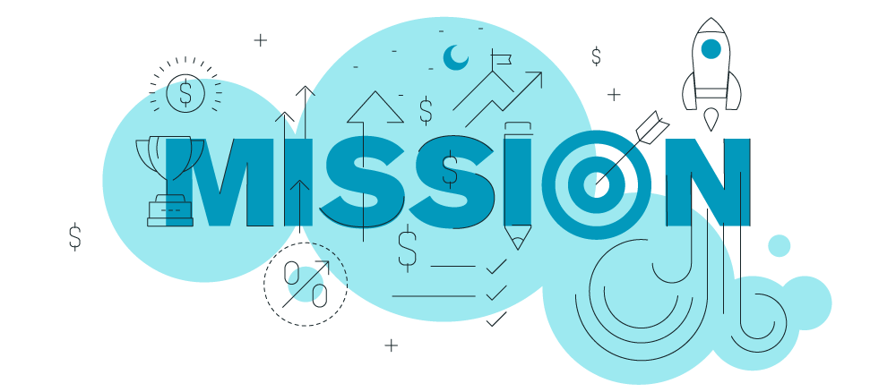
Our Mission (Deliverables)
To deliver a Mobile and Web Application that will support artists and artisans and promote their work & skills while also earning them a respectable living, regardless of any biases.

Slide 5
Why Do We Care?
Pakistan, in general, has immense amount of talent with reference to art and culture.
Art promotion in Pakistan is not given significant importance with respect to sales and purchase.
An online platform is the cheapest and easiest way to reach maximum global market.
As a bearer of Yohsin philosophy, we aim to cultivate the talent from neglected classes and communities (precisely the transgender community) and help them earn a respectable living.

Slide 6
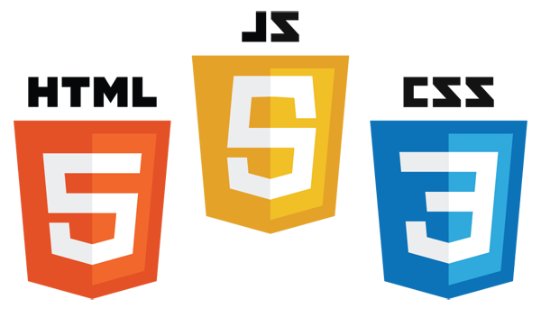




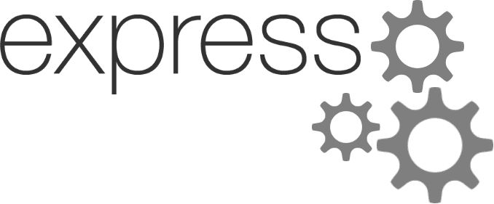





Tools and Technologies*
We will be using these technologies to build our website, maintain our repository and design our user interface.
Front End Frameworks/Libraries
Back End Frameworks/Libraries
Database and Hosting
Android Development
*Subject to change
Special Mentions

Slide 7
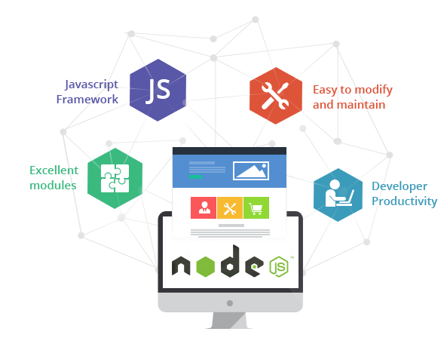
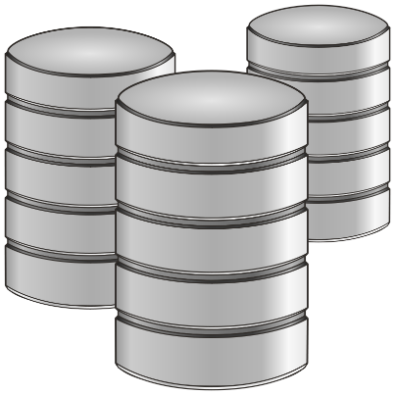
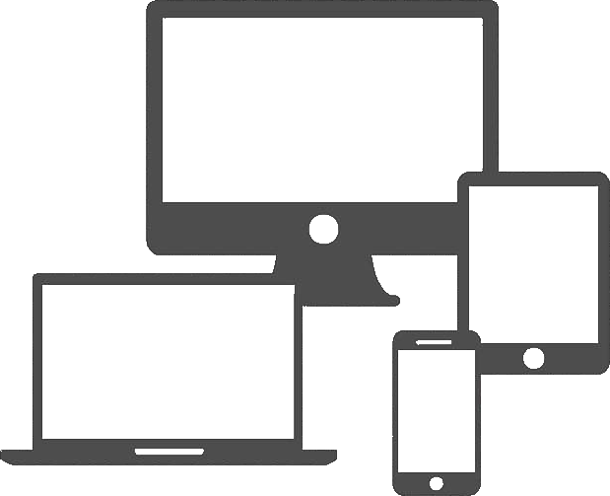
Major Components of our Project
Database Systems
Web and App Development
Intro To Illustration
Design Thinking
Entrepreneurship and Management
Web and App Development

Slide 8
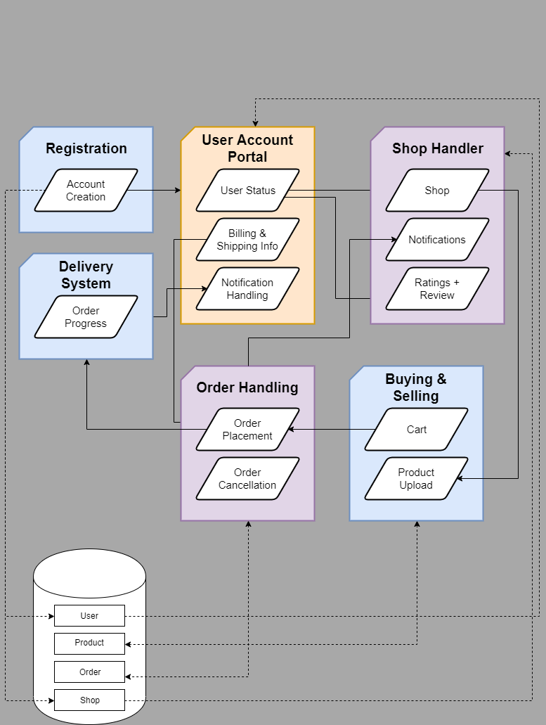
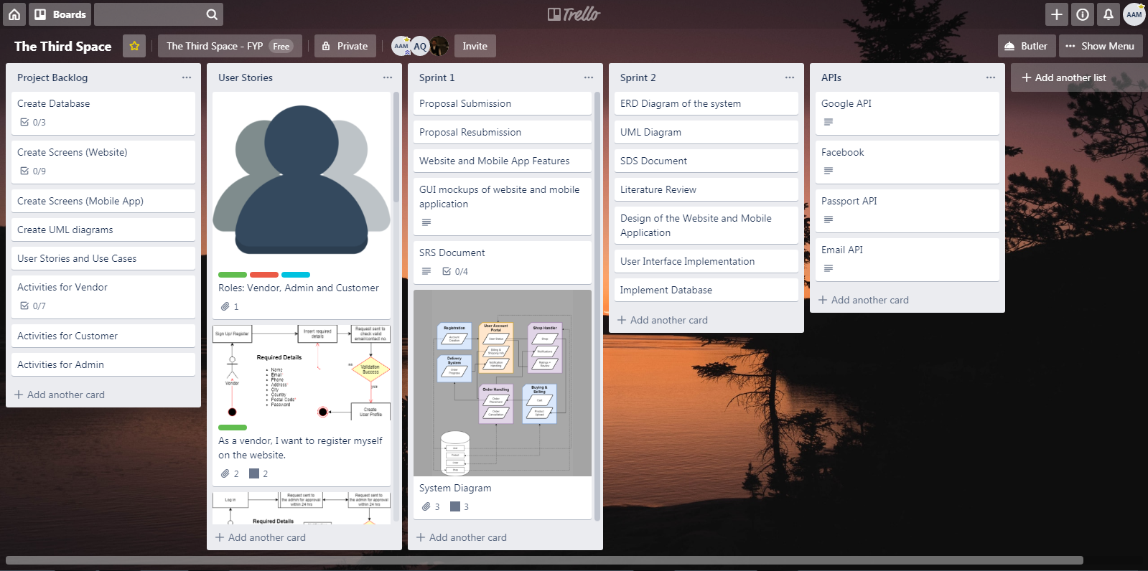
Proposal feedback
THROWBACK
System diagram
Project Backlog
Screens for Mobile App:
Login Page
Home Screen
Shop Page
Upload Items Page
Screens for Website:
Login Page/ Sign Up
Home Screen
User Profile
Shop Page
Items Page
Blog Page
About Page
Shopping Cart
User Guide
UML Diagram
User Stories
Use Cases
Databases:
ERDs
Normalization of tables
Dummy data
Trello Board
GUI mockups*
Kaavish WG pointed out that our proposal should be more focused towards easing the process.
As per the feedback received, we streamlined the scope of our project and included a mobile app in our project which is locally contextualized, and has an easy-to-use interface.
For Web Application GUI Mockups: https://app.moqups.com/crvs7Jw1Tr/view/page/a2a00afc0
For Mobile Application GUI Mockups: https://marvelapp.com/jaefbg9
Link to Trello Board: https://trello.com/b/tVpznKzH/the-third-space
*Subject to change

Slide 9
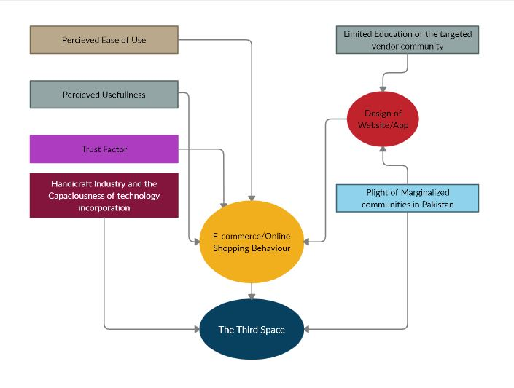
LITERATURE REVIEW: A CONCEPTUAL FRAMEWORK
Link to Online Document: https://www.papeeria.com/p/690c65b3ea665c1f0d55fd141cb2127d#/Kaavish+Report/chapters/review.tex

Slide 10
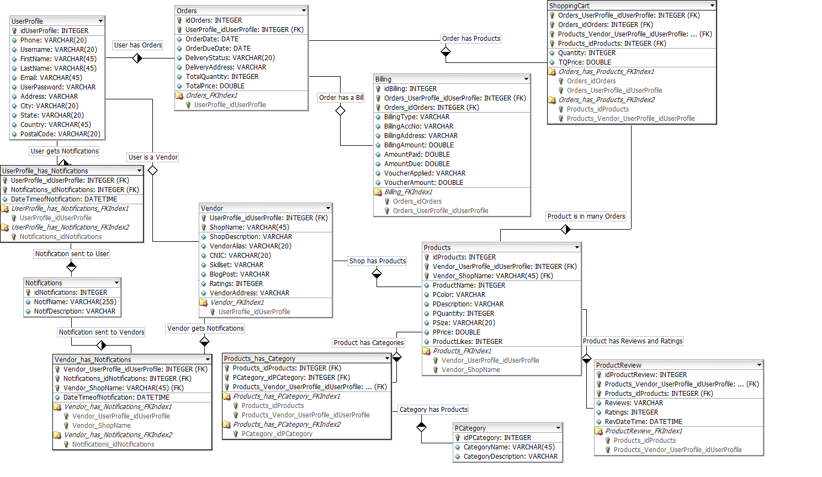
DESIGN: ENTITY RELATIONSHIP DIAGRAM

Slide 11
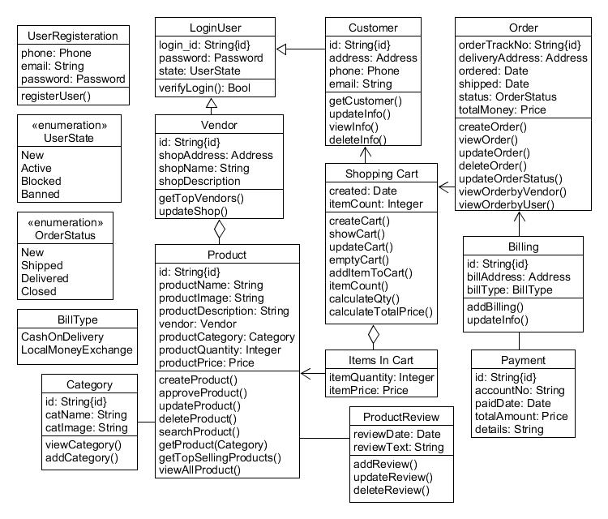
DESIGN: UML CLASS DIAGRAM

Slide 12
PROJECT PROTOTYPE
LINK TO LOCALHOST WEBSITE

Slide 13
Challenges
Most of the APIs are paid and we need funds (or alternative free APIs) for the execution of our project
To host our website and mobile app, we again need to generate funds or sponsorships.

Slide 14


